Slide 1
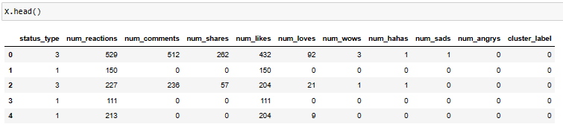
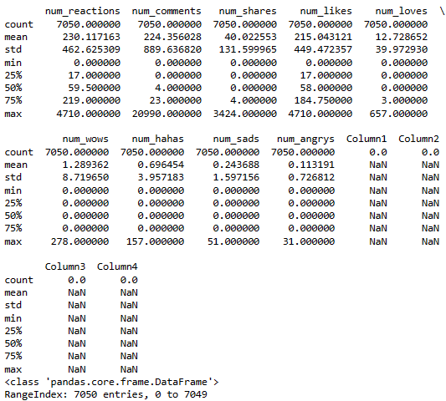
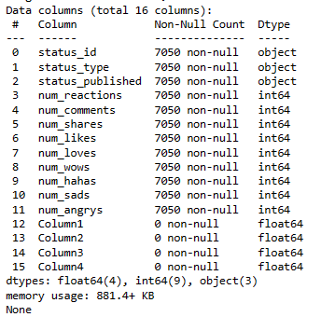
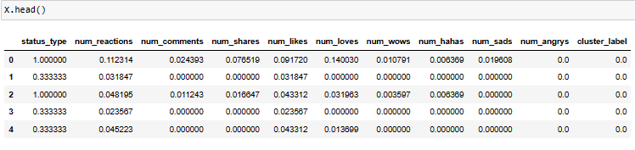
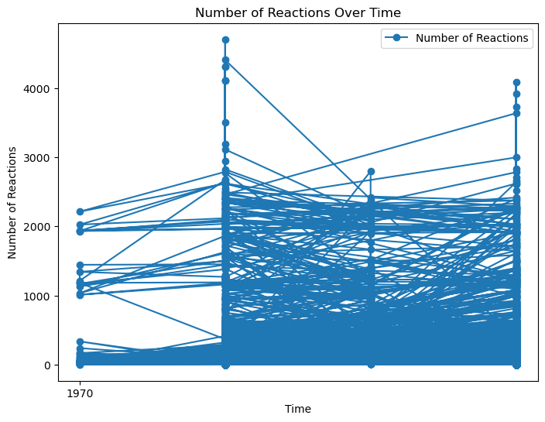
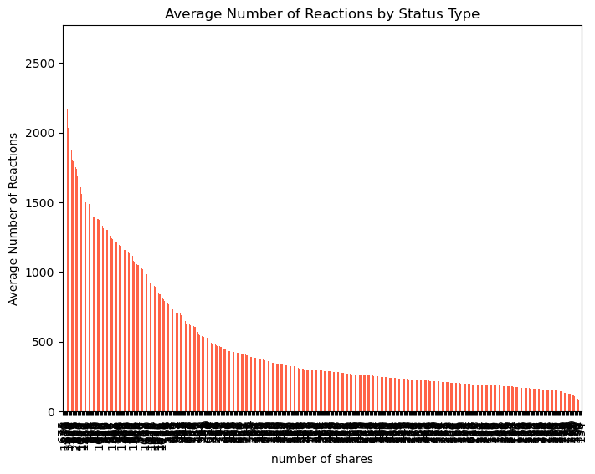
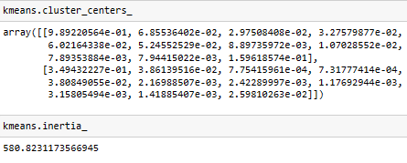
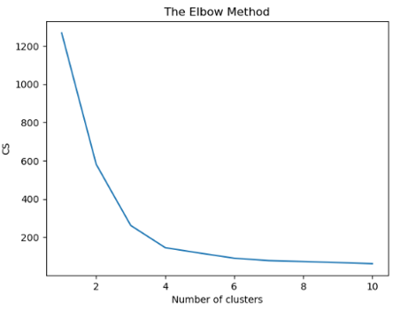
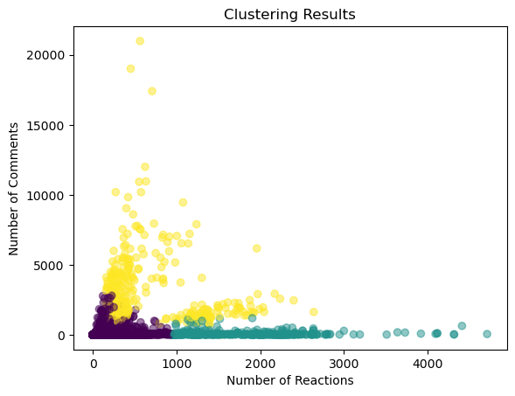
ANALYSING FACEBOOK LIVE MERCHANTS
Introduction
Result Analysis
GOAL 3: Data Preprocessing for Model Fitting
This Python project explores the commitment examples of Facebook Live merchants in Thailand, utilizing a dataset that incorporates pointers like as reactions, remarks, and offers.
The principal stage is information stacking, in which we use pandas to import the dataset, do a central measurable examination, and check for missing qualities.
Following that, a bunching examination utilizing K-implies, utilizing factors like reactions, criticism, and offers to identify patterns in dealer movement.
GOAL 1: Data Loading and Exploration
Developing a property vector involves indicating a bunch of factors that address qualities.
The table underneath shows every one of the underlying five sections of the crude informational index after scaling the elements.
During the element scaling process, the dataset's mathematical parameters (sections) assigned by X are changed by utilizing sklearn's MinMaxScaler
The table shows the initial five lines that involve the preprocessed dataset 'X', which incorporates qualities like ' status_type,' 'num_reactions,' 'num_comments,' as well as 'cluster_label.’
Highlight scaling switches mathematical parameters over completely to a normalized range, which supports perception.
The dataset has 7050 records in 16 sections that show virtual entertainment post details.
Key information shows different levels of communication, with normal reactions of 230.12, remarks around 224.36, as well as remarks of 40.02.
The dataset summary shows that a few segments, explicitly 'Column1' through 'Column4', have a raised number of values that are absent (7050 contrasted with the all-out lines).
The code translates this 'status_type' section from the DataFrame 'information' onto the date and time design and produces a line plot of the 'num_reactions' as time passes by.
The plot, which incorporates markers and names, portrays the example in responses, working with time-sensitive examination.
Aims and Objectives
Aim
The main focus of this project is to inspect a virtual entertainment dataset and proper calculation which incorporates information stacking, examination, and gathering to track down conventions.
Objectives
To stack and analyze the dataset, survey the measurements and search for missing qualities.
To use K-means clustering to distinguish designs in client association.
To plan proper information for highlight classification, change, and scaling.
To utilize K-Means clustering for groupings with various bunch counts.
The Elbow Technique is utilized to recognize the best number of groups.
To work with cognizance, the order and clustering results ought to be shown.
To acquire significant information about online entertainment client lead and commitment designs.
GOAL 4: K-Means Clustering for Classification
The K-Means strategy is utilized for clustering, utilizing two foreordained gatherings and a decent condition of haphazardness (0) to guarantee repeatability in information point order given similarity.
The cluster_centers_ exhibit holds the directions and cluster focuses in a multi-layered space, which uncovers each cluster's center propensity.
The code utilizes the greatest Elbow Strategy to work out the right measure of clusters utilizing the K-Means division (Liu et al. 2023).
It emphasizes over-cluster sums, computes the all-out number of square squared distances (idleness), as well as shows the outcomes to outwardly distinguish the ideal cluster number.
The K-implies model precisely sorted 4288 from a sum of 7050 examples, for an exactness rating of around 61%. Figure 15 shows the outcomes acquired from the model utilizing two clusters.
Background
In the advanced age, virtual entertainment networks assume a significant part in associating individuals, passing on data, and empowering contributions.
Understanding client conduct and in general commitment designs across these stages is basic for associations, advertisers, and analysts hoping to improve their substance and effort drives (Liu et al. 2023).
The dataset being referred to includes data on client reactions, input, and offers for postings on an interpersonal interaction site.
The principal period of information investigation looks to give measurable experiences and recognize likely issues, like missing numbers.
Thus, clustering strategies, strikingly K-means, might be utilized to find basic examples in client association measures.
Normalizing information and utilizing group marks make it more straightforward to imagine different client fragments.
GOAL 2: Clustering
Clustering is performed utilizing the suitable lines and segments 'num_reactions' and 'num_shares’.
The information is standardized and KMeans clustering is utilized, with the outcomes saved inside a new 'cluster_label' section in the dataset (Yin et al. 2023).
This code makes a dispersed plot to imagine the clustering discoveries. Every point addresses the data occurrence and is variety-coded by its cluster.
This code outlines the clustering discoveries by charting client responses and remarks. The scattered dots demonstrate data of interest, which are variety-coded by cluster.
Moreover, red 'X' images recognize cluster focuses, which give experiences in client association designs.
Methods
Fundamental measurements including mean, standard deviation, and among quartiles were determined to get an understanding of variable appropriation.
Furthermore, missing qualities were found and adjusted to guarantee information adequately (Paraman et al. 2022).
The examination extended to all out factors, explicitly ' status_type,' which uncovered the recurrence dissemination of different post classes.
Applicable qualities, like the aggregate sum of reactions, input, and offers, were picked and normalized to ensure scale consistency.
The Elbow Strategy had been carried out methodically to lay out the proper number of bunches, which worked on the exactness of the accompanying arrangement.
Conclusion
The characterization results showed great precision, showing the way that the model can separate between cooperation levels.
The discoveries of this examination assist organizations and advertisers with acquiring superior information on internet-based local area elements, permitting them to redo strategies for upgraded crowd investment.
Addressing the further examination and clustering of new factors might work on the exactness of clustering alongside arrangement, giving more nuanced experiences about the project.
Notes:
ASSIGNMENT 3: CLUSTERING AND FITTING
Introduction
This Python project explores the commitment examples of Facebook Live merchants in Thailand, utilizing a dataset that incorporates pointers like as reactions, remarks, and offers. The principal stage is information stacking, in which we use pandas to import the dataset, do a central measurable examination, and check for missing qualities. Following that, a bunching examination utilizing K-implies, utilizing factors like reactions, criticism, and offers to identify patterns in dealer movement. Moreover, the project utilized curve_fit to fit models, explore time series or trademark associations, and gauge future qualities.
Aim and Objectives
Aim
The main focus of this project is to inspect a virtual entertainment dataset and proper calculation which incorporates information stacking, examination, and gathering to track down conventions.
Objectives
To stack and analyze the dataset, survey the measurements and search for missing qualities.
To use K-means clustering to distinguish designs in client association.
To plan proper information for highlight classification, change, and scaling.
To utilize K-Means clustering for groupings with various bunch counts.
The Elbow Technique is utilized to recognize the best number of groups.
To work with cognizance, the order and clustering results ought to be shown.
To acquire significant information about online entertainment client lead and commitment designs.
Background
In the advanced age, virtual entertainment networks assume a significant part in associating individuals, passing on data, and empowering contributions. Understanding client conduct and in general commitment designs across these stages is basic for associations, advertisers, and analysts hoping to improve their substance and effort drives (Liu et al. 2023). The dataset being referred to includes data on client reactions, input, and offers for postings on an interpersonal interaction site. The principal period of information investigation looks to give measurable experiences and recognize likely issues, like missing numbers. Thus, clustering strategies, strikingly K-means, might be utilized to find basic examples in client association measures. Normalizing information and utilizing group marks make it more straightforward to imagine different client fragments.
Methods
Fundamental measurements including mean, standard deviation, and among quartiles were determined to get an understanding of variable appropriation. Furthermore, missing qualities were found and adjusted to guarantee information adequately (Paraman et al. 2022). The examination extended to all out factors, explicitly ' status_type,' which uncovered the recurrence dissemination of different post classes. Applicable qualities, like the aggregate sum of reactions, input, and offers, were picked and normalized to ensure scale consistency. The Elbow Strategy had been carried out methodically to lay out the proper number of bunches, which worked on the exactness of the accompanying arrangement.
Result Analysis
GOAL 1: Data Loading and Exploration
Figure 1: Displaying basic statistics and information
The dataset has 7050 records in 16 sections that show virtual entertainment post details. Key information shows different levels of communication, with normal reactions of 230.12, remarks around 224.36, as well as remarks of 40.02. The dataset contains an assortment of post sorts and incorporates quantitative components like reactions and remarks, as well as straight-out factors.
Figure 2: Checking the missing values and exploring the values in columns
The dataset summary shows that a few segments, explicitly 'Column1' through 'Column4', have a raised number of values that are absent (7050 contrasted with the all-out lines). The'status_type' field has four interesting sorts ('picture', 'video', 'status', and 'interface'). The most widely recognized class is 'picture' (4288 sections), trailed by 'video' (2334),' status' (365), along 'connect' (63).
GOAL 2: Clustering
Figure 3: Applying the K Means clustering to normalize the data
Clustering is performed utilizing the suitable lines and segments 'num_reactions' and 'num_shares'. The information is standardized and KMeans clustering is utilized, with the outcomes saved inside a new 'cluster_label' section in the dataset (Yin et al. 2023). Figure 3 shows the sending utilizing KMeans clustering after information standardization.
Figure 4: Clustering results for primary areas of the dataset
This code makes a dispersed plot to imagine the clustering discoveries. Every point addresses the data occurrence and is variety-coded by its cluster. The realistic shows the connection between the aggregate sum of endless remarks.
Figure 5: Clustering results with properly identified centers
This code outlines the clustering discoveries by charting client responses and remarks. The scattered dots demonstrate data of interest, which are variety-coded by cluster. Moreover, red 'X' images recognize cluster focuses, which give experiences in client association designs.
Figure 6: Viewing the results labels in different kinds of variables after clustering
This code outlines the clustering discoveries by charting client responses and remarks. The scattered dots demonstrate data of interest, which are variety-coded by cluster. Moreover, red 'X' images recognize cluster focuses, which give experiences in client association designs (Jin et al. 2023).
GOAL 3: Data Preprocessing for Model Fitting
Figure 7: Declaring attribute vector and converting unqualified variables into integers
Developing a property vector involves indicating a bunch of factors that address qualities. Switching unqualified factors over completely to whole numbers is the most common way of changing non-mathematical factors into mathematical qualities for numerical calculation or AI application.
Figure 8: Visualising the results of conversion
The table shows the initial five lines that involve the preprocessed dataset 'X', which incorporates qualities like ' status_type,' 'num_reactions,' 'num_comments,' as well as 'cluster_label.' The segments reflect properties, for example, reaction counts, comment numbers, and a gathering name decided to utilize K-means clustering.
Figure 9: Feature scaling interpretation process
During the element scaling process, the dataset's mathematical parameters (sections) assigned by X are changed by utilizing sklearn's MinMaxScaler. The resultant scaled information is then turned around into a data frame with the first section names.
Figure 10: Visualising the results of feature scaling
The table underneath shows every one of the underlying five sections of the crude informational index after scaling the elements. Highlight scaling switches mathematical parameters over completely to a normalized range, which supports perception. Each column shows standardized information for a few commitment measures and bunch names, making it simpler to dissect the outcomes.
GOAL 4: K-Means Clustering for Classification
Figure 11: K-Means model buildup with two clusters
The KMeans strategy is utilized for clustering, utilizing two foreordained gatherings and a decent condition of haphazardness (0) to guarantee repeatability in information point order given similarity.
Figure 12: Created models parameter study program
The cluster_centers_ exhibit holds the directions and cluster focuses in a multi-layered space, which uncovers each cluster's center propensity. The inactivity esteem, 580.8231173566945, is the absolute of the squared distances interfacing data of interest and their cluster habitats.
Figure 13: Accuracy determination of the current model
this representation elaborates on cluster names that are allocated by the clustering strategy K-means and thinks about them as genuine marks (y). The print proclamations show the complete number of right marks as well as the exactness score, which gives data about the clustering calculation's presentation (61%).
Figure 14: Using the elbow method to uncover optimal numeral values of clusters
The code utilizes the greatest Elbow Strategy to work out the right measure of clusters utilizing the K-Means division (Liu et al. 2023). It emphasizes over-cluster sums, computes the all-out number of square squared distances (idleness), as well as shows the outcomes to outwardly distinguish the ideal cluster number.
Figure 15: Results of K-means model with two clusters
The K-implies model precisely sorted 4288 from a sum of 7050 examples, for an exactness rating of around 61%. Figure 15 shows the outcomes acquired from the model utilizing two clusters.
Figure 16: Results of K-Means model with 3 clusters
The K-Means model successfully categorized 136 samples of the total amount of sales, yielding a classification score of 0.02. Figure 16 shows the results obtained from the model that includes three different clusters, demonstrating the usefulness of the clustering method.
Figure 17: Results of K-Means model with 4 clusters
In the assessment, the K-Means calculation that included four clusters accurately recognized 190 cases out of 700, figure 17 portrays a precision score of generally 0.28 using proper technical analysis.
Conclusion
The characterization results showed great precision, showing the way that the model can separate between cooperation levels. The discoveries of this examination assist organizations and advertisers with acquiring superior information on internet-based local area elements, permitting them to redo strategies for upgraded crowd investment. Addressing the further examination and clustering of new factors might work on the exactness of clustering alongside arrangement, giving more nuanced experiences about client conduct has created patterns across time to offer a total image of Thailand's Facebook Live business ecosystem.

